Slide 1

GRAD 695: How to conduct Research for a Lit Review
Library

Slide 2



Librarians
Laura Wukovitz,
Resources Librarian
David Runyon,
University Librarian
Loren Nocheck,
Resources Librarian

Slide 3
Agenda
Searching Google Scholar
HU Library resources available to you
How to search EBSCOhost
Web of Science

Slide 4

What is a Literature Review?

Slide 5
What is a Literature Review?
A “lit review” is a work (or section of a work) that presents the historical context AND current situation about a certain topic using writings by experts in the field.
Usually a lit review begins with background information about a subject, then becomes more focused on a specific area.

Slide 6
How do I conduct research for a lit review?
Look for primary literature and foundational sources, including:
Statistics
Scientific studies
Case studies
Reports
Government documents
Professional standards, policies, guidelines, or best practices

Slide 7
How do I conduct research for a lit review?
Look for other lit reviews in your field about your topic.
Who are the “leading experts” in your field?
Look for author’s names to be repeated in multiple lit reviews
If using EBSCO, look at PlumX metrics

Slide 8

How do I conduct research for a lit review?
Look for other lit reviews in your field about your topic.
Who are the “leading experts” in your field?
Look for author’s names to be repeated in multiple lit reviews
If using EBSCO, look at PlumX metrics
Follow the “Citation Trail”

Slide 9
Strategy: Lit Reviews
TI Title or AB Abstract search for the terms:
Literature Review
Systematic Review
Systematic Literature Review
Meta-analysis

Slide 10
Strategy: Lit Reviews
Locate already published literature reviews (or academic studies that have a lengthy lit review section) about your topic.
Take special note of any studies included in the lit review that you want to learn more about
Locate those studies that interest you
Sort and save the studies to your EBSCO account, folders on your computer, or a citation manager
If necessary, request any articles using the Interlibrary Loan
Search some more!

Slide 11
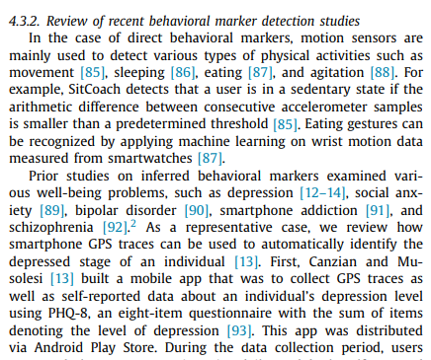

Slide 12
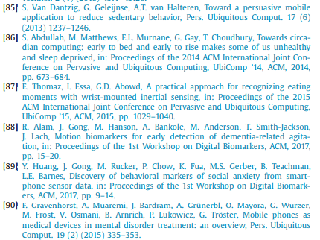

Slide 14
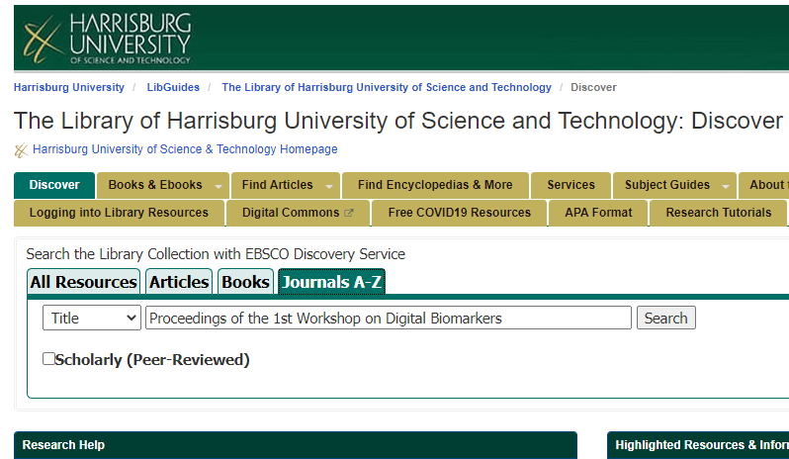
Search the library for the item

Slide 15
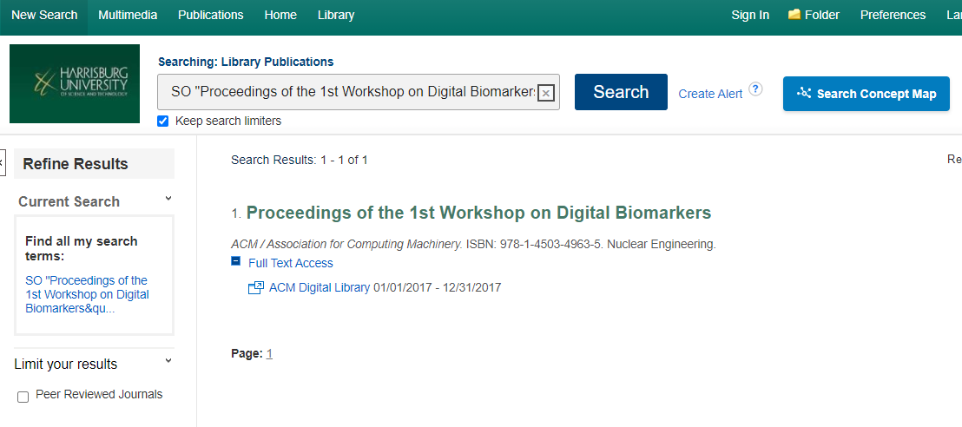
Look for a link under “Full Text Access”

Slide 16
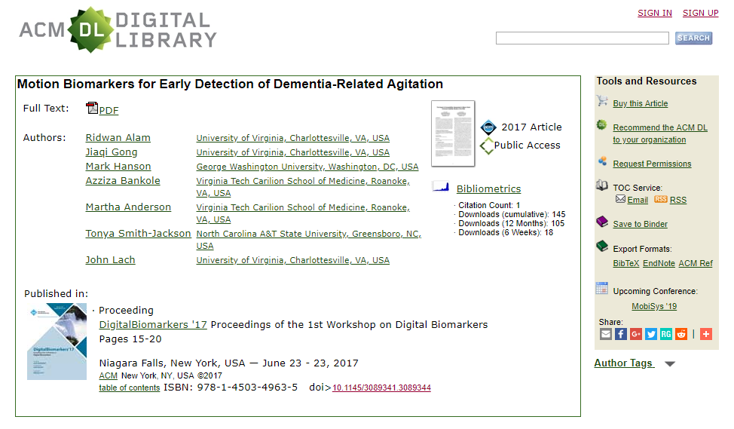

Slide 17
Strategy: Academic Studies
Locate a study that is interesting to you. In the Discussion or Conclusion section:
Look for “more research is needed . . .”
Look at limitations – able to replicate study without some of the limitations?
See what else the author has written
AU Author search in EBSCO
If an author’s name is hyperlinked, click it
Use Web of Science “Cited Reference Search” to identify later studies that cited the original article you found (doi: 10.1016/j.cor.2011.07.007)

Slide 18
Searching
Basic Search
Advanced Search
Search Results
Searching for e-books

Slide 19
How do you know when you’ve finished searching?
When I’ve read everything written about my topic!

Slide 20

How do you know when you’ve finished searching?
When I’ve read everything written about my topic!

Slide 21

How do you know when you’ve finished searching?
Think of a lit review as a current snapshot of your topic. Information and knowledge about your topic are always evolving in the field – it never stops! You are doing your best to capture the strongest themes of your topic at this point in time.

Slide 22
How do you know when you’ve finished searching?
When you are satisfied that you have a picture of your topic that adequately presents the current situation, then you are “done.”

Slide 23
Synthesizing
Provide the information
Interpret the information
Say why the information is important. Think “So what?”

Slide 24
Research Question:
How do academic libraries contribute to undergraduate student retention?

Slide 25
How do academic libraries contribute to undergraduate student retention?
SYNTHESIZING
We might consider student use of:
Library collection
Library services
Library instruction
And compare these to student grades & retention

Slide 26
The literature says . . .
SYNTHESIZING
O’Kelly (2015)
The study:
Measured student retention in
VS.
The result:
Correlation to retention due to formal library instruction was highest with freshmen and graduate students (p. 24).
Courses that had a librarian visit and teach a lesson at least once
Courses that had no instruction by librarians

Slide 27
The literature says . . .
SYNTHESIZING
Soria, Fransen, & Nackerud (2013)
The study:
Compared student library use vs. library instruction as a predictor of retention of college freshmen
VS.
The result:
“Library usage is associated with first-year students’ retention and academic success” (p. 18).
Library “Use”:
Loans
Database Use
Library Website Use
Computer workstations in library
Library Instruction:
Workshops
Lessons in classes
Orientation
Research help

Slide 28
The literature says . . .
SYNTHESIZING
Vance, Kirk, & Gardner (2012)
The study:
Analyzed student records to compare both GPA and retention rates for students who:
VS.
The result:
There is a statistically significant impact between library instruction in students’ first year and both GPA and retention rates (pp. 54-55).
Received formal library instruction as freshmen
Received no formal library instruction as freshmen

Slide 29
The literature says . . .
SYNTHESIZING
Australian Council for Educational Research (2008)
The study:
Analyzed data from the 2008 Australian Survey of Student Engagement (AUSSE) to compare how often students visited the library and their intention to depart their university:
The result:
Students who visit the library more frequently are more likely to be retained (p.1).
NEVER: 40%
VERY OFTEN: 28%
SOMETIMES: 36%
OFTEN:
34%

Slide 30
Let’s try synthesizing a couple sentences together!
SYNTHESIZING
Results:
Correlation to retention due to formal library instruction was highest with freshmen and graduate students (O’Kelly, 2015, p. 24).
“Library usage is associated with first-year students’ retention and academic success” (Soria, Fransen, & Nackerud, 2013, p. 18).
There is a statistically significant impact between library instruction in students’ first year and both GPA and retention rates (Vance, Kirk, & Gardner, 2012, pp. 54-55).
Students who visit the library more frequently are more likely to be retained (ACER, 2008, p.1).

Slide 31
Libraries and librarians can play a critical role in student retention, especially for freshmen, if they actively seek to try. Studies indicate that library instruction (whether formal or informal) impacts both GPA and retention rates in a statistically significant way (O’Kelly, 2015, p. 24; Vance, Kirk, & Gardner, 2012, pp. 54-55). Complementary studies also demonstrate that not only library instruction, but also student usage of libraries, is a reliable predictor of student retention (Soria, Fransen, & Nackerud, 2013, p. 18; Australian Council for Educational Research, 2008, p. 1). Librarians should endeavor to find ways to increase instruction opportunities and aggressively market library services and resources in an effort to retain the most vulnerable students, college freshmen.

Slide 32
Results of studies in published literature
Libraries and librarians can play a critical role in student retention, especially for freshmen, if they actively seek to try. Studies indicate that library instruction (whether formal or informal) impacts both GPA and retention rates in a statistically significant way (O’Kelly, 2015, p. 24; Vance, Kirk, & Gardner, 2012, pp. 54-55). Complementary studies also demonstrate that not only library instruction, but also student usage of libraries, is a reliable predictor of student retention (Soria, Fransen, & Nackerud, 2013, p. 18; Australian Council for Educational Research, 2008, p. 1). Librarians should endeavor to find ways to increase instruction opportunities and aggressively market library services and resources in an effort to retain the most vulnerable students, college freshmen.

Slide 33
Results of studies in published literature
Libraries and librarians can play a critical role in student retention, especially for freshmen, if they actively seek to try. Studies indicate that library instruction (whether formal or informal) impacts both GPA and retention rates in a statistically significant way (O’Kelly, 2015, p. 24; Vance, Kirk, & Gardner, 2012, pp. 54-55). Complementary studies also demonstrate that not only library instruction, but also student usage of libraries, is a reliable predictor of student retention (Soria, Fransen, & Nackerud, 2013, p. 18; Australian Council for Educational Research, 2008, p. 1). Librarians should endeavor to find ways to increase instruction opportunities and aggressively market library services and resources in an effort to retain the most vulnerable students, college freshmen.
So what?
Original interpretation gives meaning and importance.

Slide 34
Keep track of your sources
Citation Generators*
KnightCite
BibMe
Citefast
EndNote – available through Web of Science
*Always double check citations from a generator – you are still responsible that your citations are correct!!

Slide 35
Endnote Online
Access Endnote Online through Web of Science.
Create a login for Web of Science and Endnote
If you log into Endnote online first, you can easily export citations from your Ebsco results into Endnote!

Slide 36
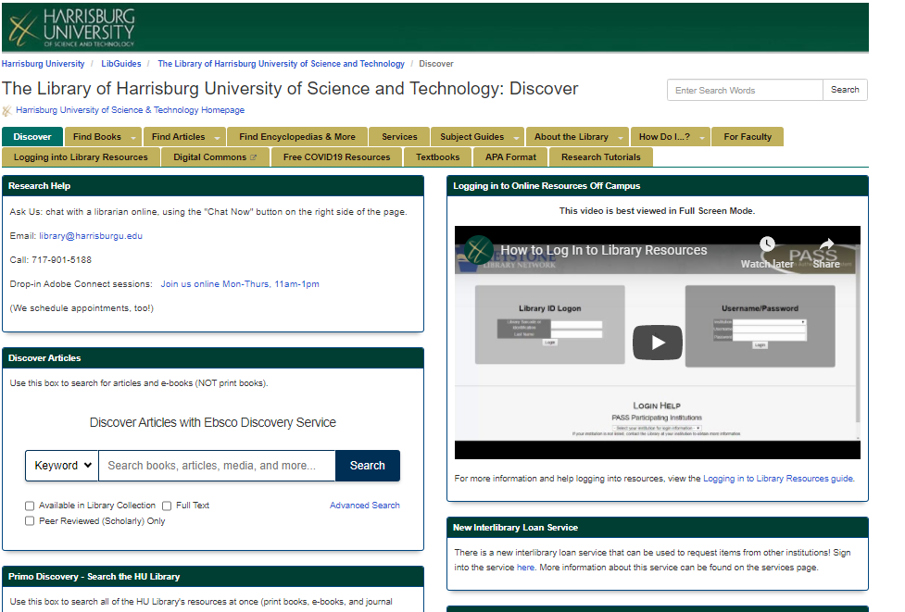
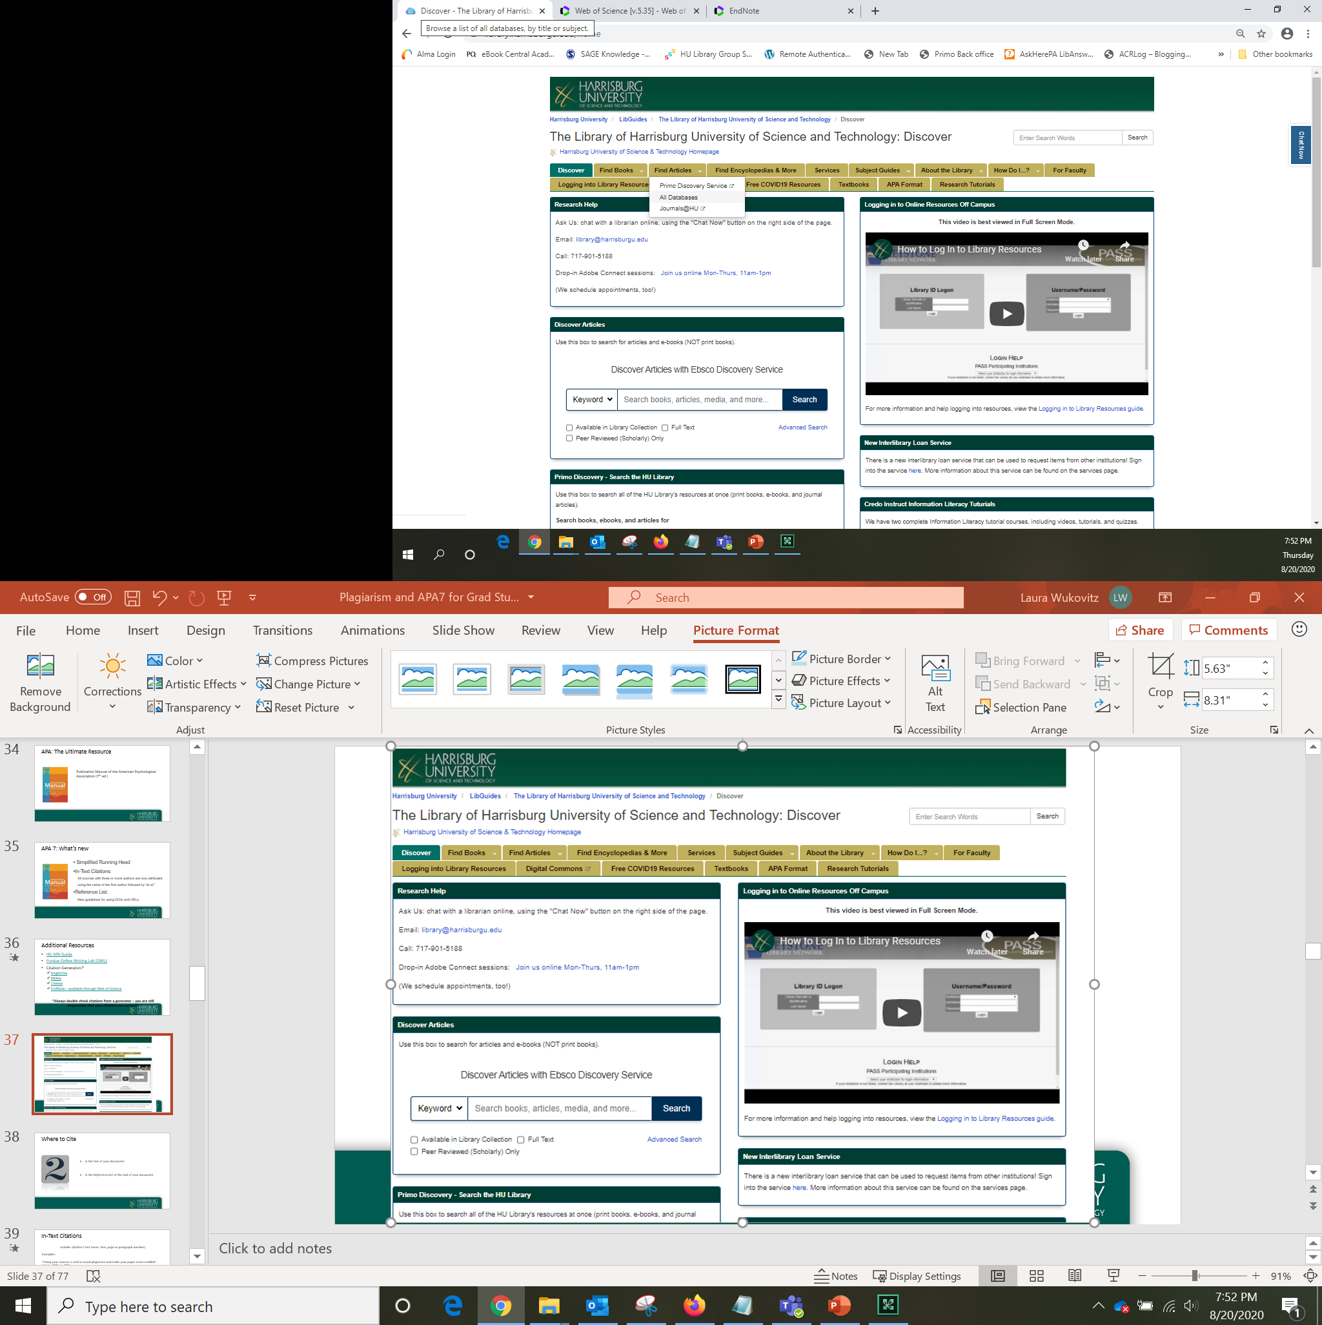
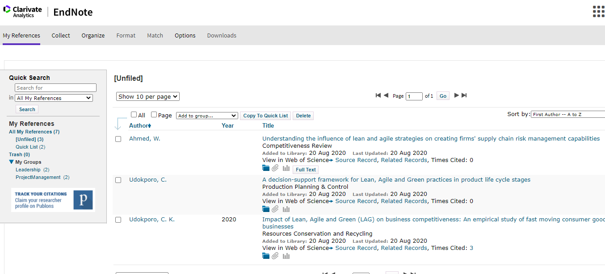
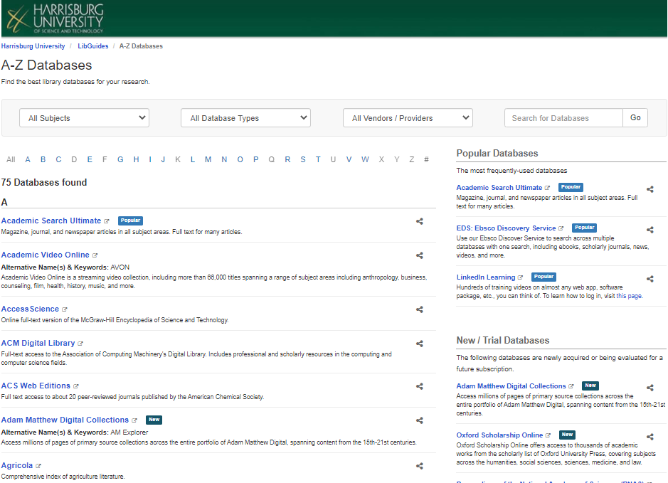
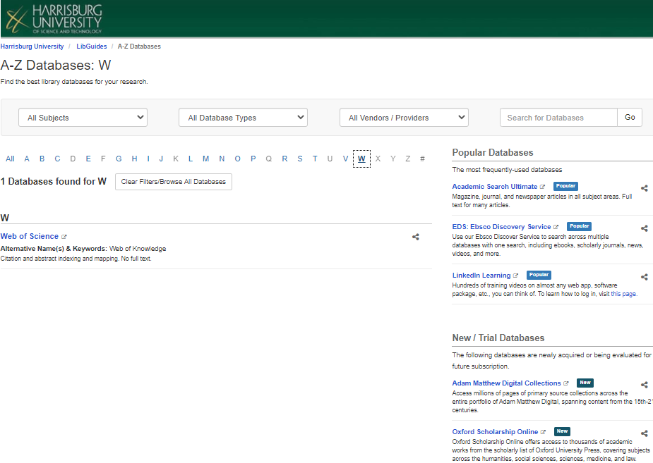
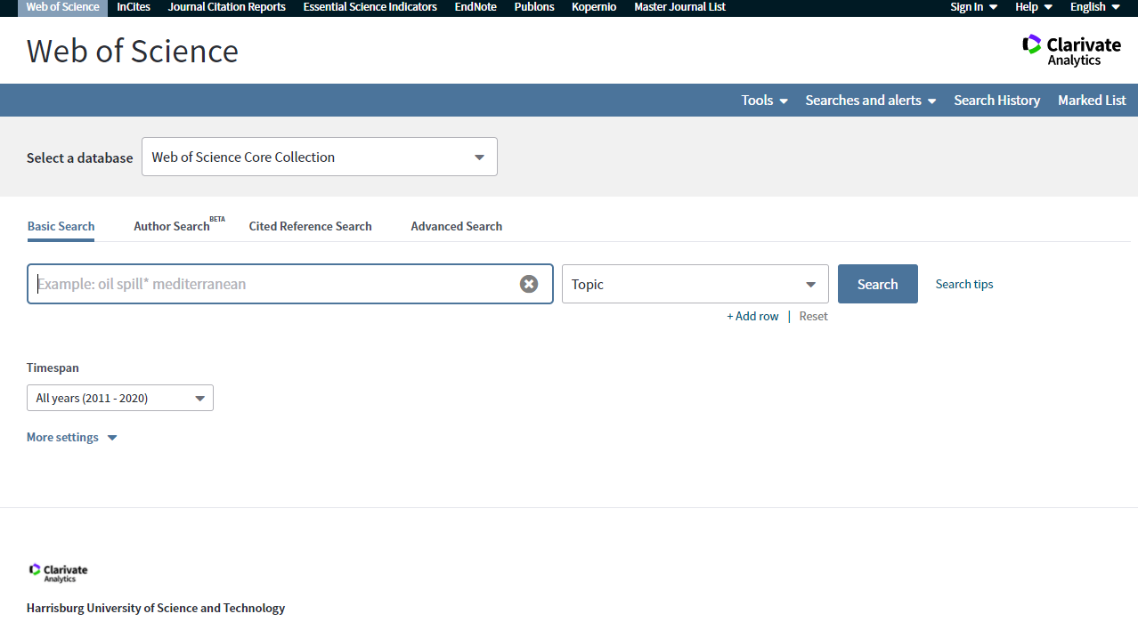

Notes:
Access Endnote Online through Web of Science. After accessing Web of Science through the library databases page, you can then create a login for Web of Science and Endnote that will allow you to save and organize your research.

Slide 37
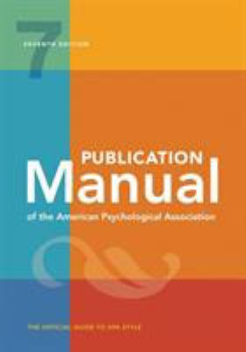
APA: The Ultimate Resource
Publication Manual of the American Psychological Association (7th ed.)

Slide 38
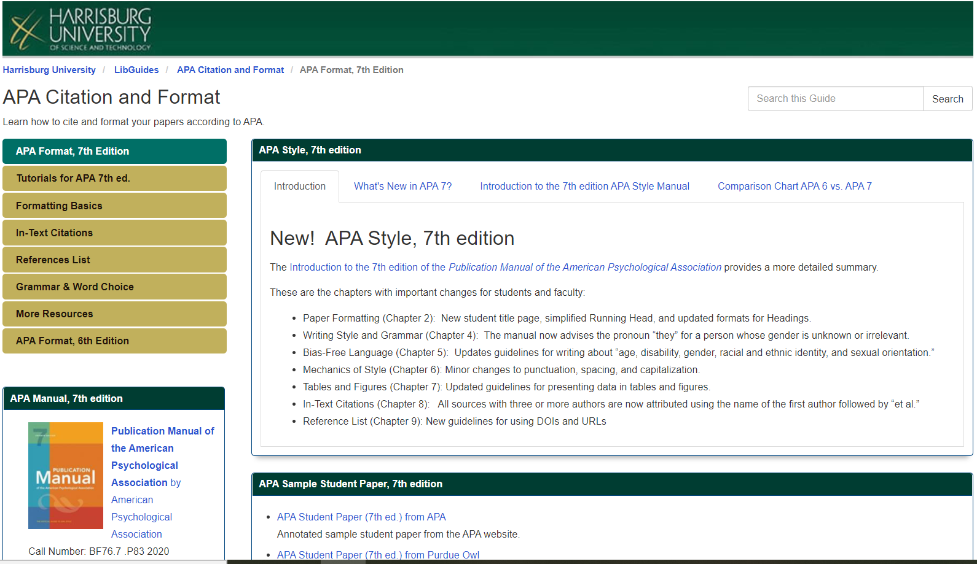
APA Guide: https://library.harrisburgu.edu/apa/

Slide 39
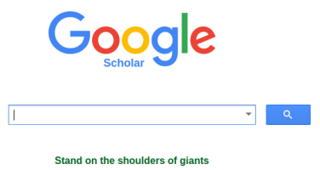
Why Google Scholar?
Google is a familiar search engine
Access to free articles
Access to citations of subscription resources
Check library resources for subscription articles!
Save items to your Google Library

Slide 40
Why NOT Google Scholar?
Scholar only has SOME information
Supplement with Library Databases (subscription materials)
Scholar links to sites like ResearchGate, which:
May have articles posted that violate the copyright (and is therefore unethical)
May be a manuscript, not the final version

Slide 41
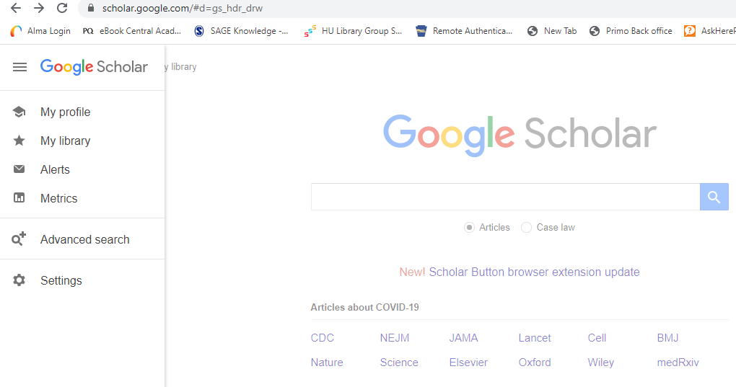
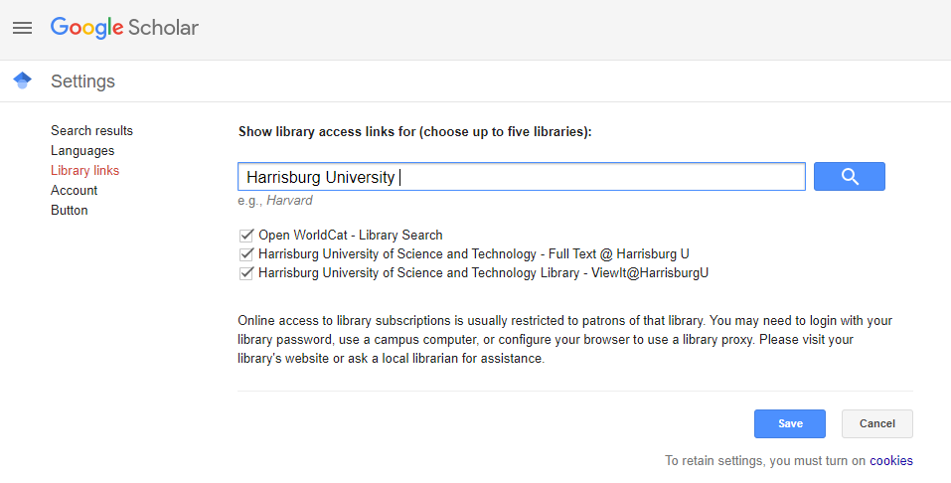
Google Scholar and the HU Library
1
2
3

Slide 42
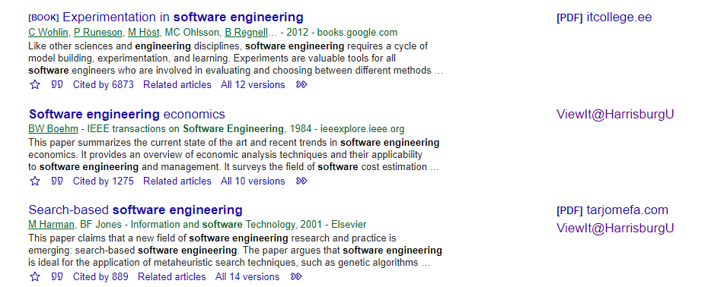
Link to full text @HarrisburgU

Slide 43
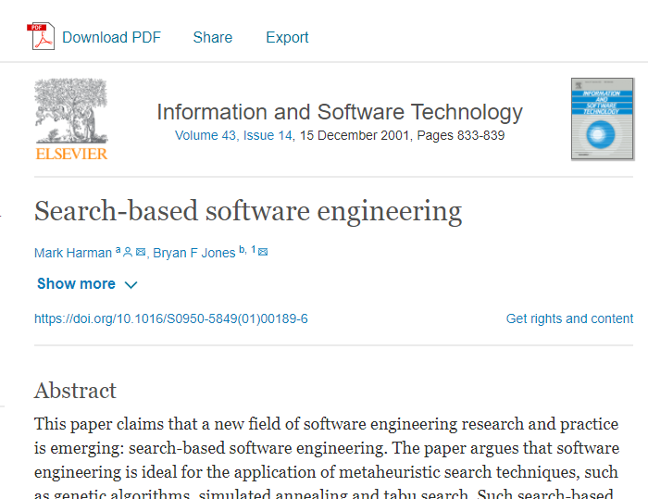

Slide 44
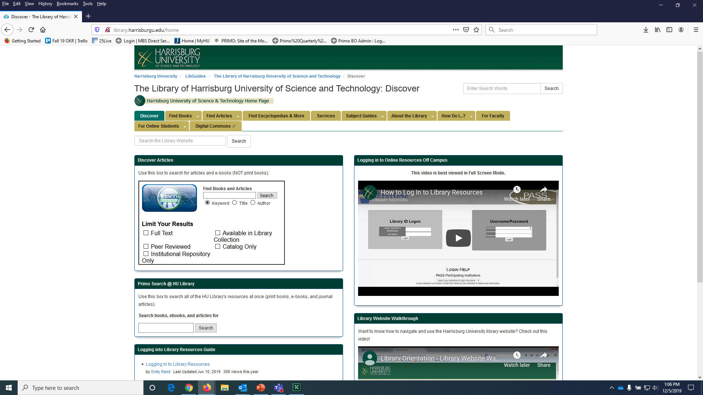
You may encounter the old login system

Slide 45
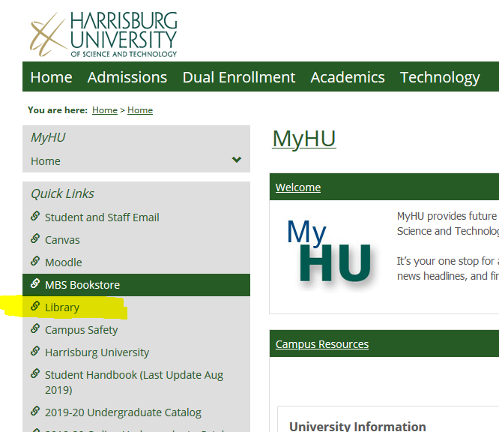
http://library.harrisburgu.edu/home

Slide 46
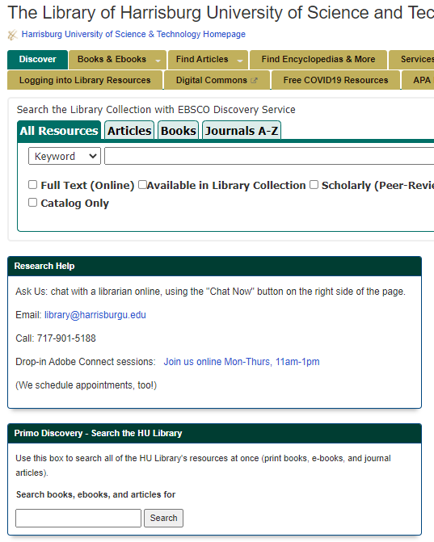
Locating Books and Journal Articles
Ebsco Discovery Service (EDS)
Searches all databases available at HU
Good for journal articles on interdisciplinary topics
Not all items are full-text
Includes many library books and ebooks
Also useful for tracking citations, using Journals A-Z
Primo Search
HU’s Library catalog
Best for locating books and ebooks
Option to expand search to include “All Resources” to find articles from all databases (often requires linking to items available through Ebsco).
“All Resources” includes citations for items not available full-text

Slide 47
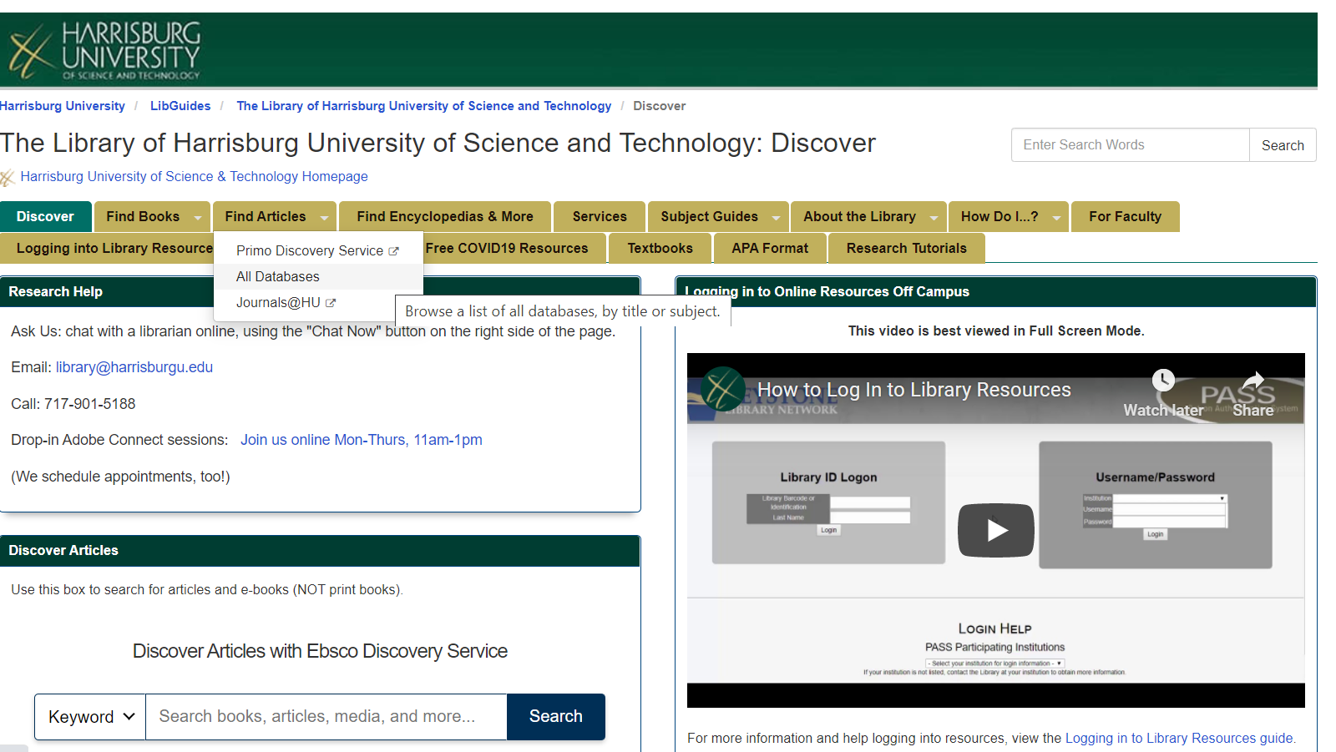
Accessing Databases by Topic
Journals@HU
Find if a specific Journal title is in our collection
All Databases:
Find resources by name or by program

Slide 48
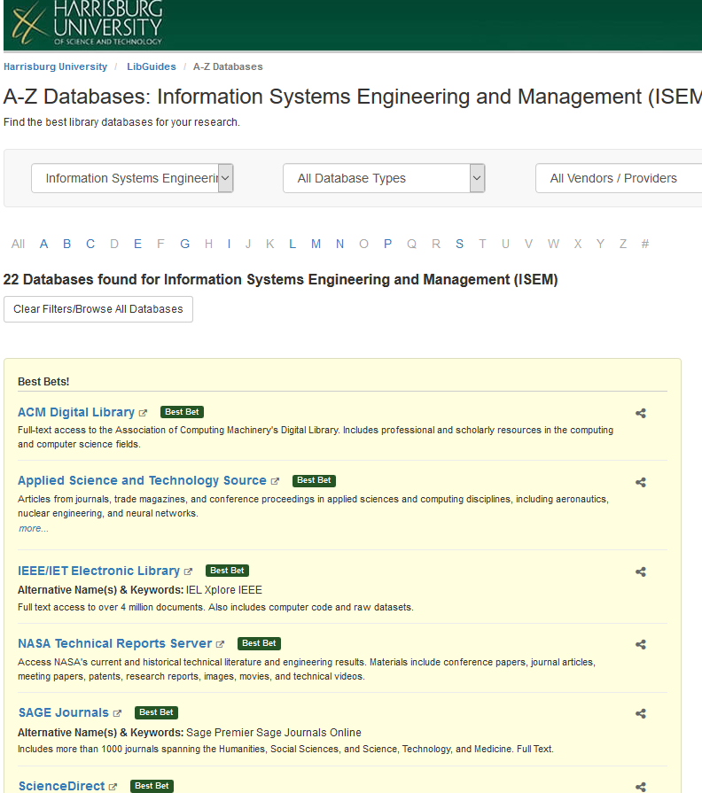
All Databases – A-Z or by Program
See everything that’s available
OR
Use the dropdown to select your program.
This will display databases with content related to your discipline.
Results can be more specific and relevant than using Primo or EDS.

Slide 49
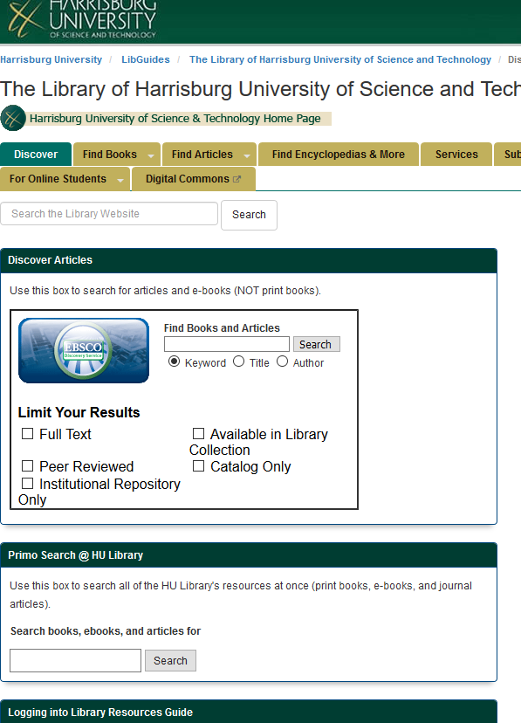
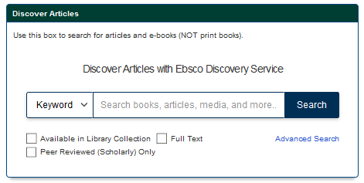
Searching Ebsco Discovery Service (EDS)
Ebsco Discovery Service (EDS)
Searches all databases available at HU
Good for journal articles on interdisciplinary topics
Not all items are full-text
Includes library books and ebooks
http://library.harrisburgu.edu/home/

Slide 50
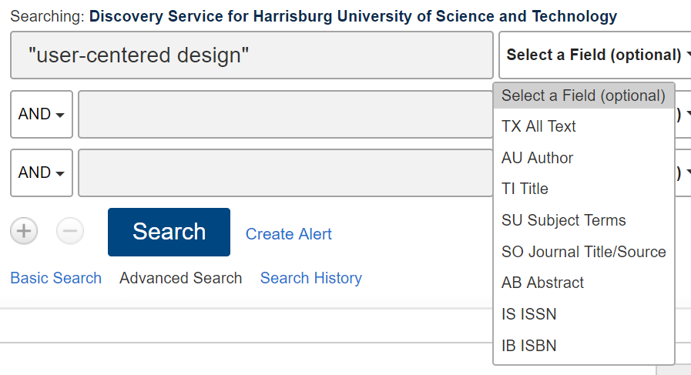
Search Fields
Keyword – (this is the default) – searches most other fields for your search terms
TX All Text
AU Author
TI Title
SU Subject Terms
AB Abstract

Slide 51
Search Tips
Quotation marks “ ” search for an exact phrase
“internet of things”
An asterisk * searches for alternate endings of a root word
Example: web* = web, webs, website, websites, webbing
nX searches for words within a certain range of each other
Example: web n5 accessibility = only results where the words “web” and “accessibility” are only five words apart or less will appear

Slide 52
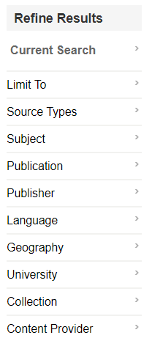
Filtering Search Results
Full Text – the library provides you with access to the entire article
Scholarly (Peer Reviewed) Journals – the article has been reviewed and approved by experts in the field
Publication Date
Source Types
Language

Slide 53

EBSCO Account
Free
Save articles
Create folders to sort saved articles
Save searches
Subscribe to journal updates
Download EBSCO ebooks

Slide 54
Strategy: Keywords
Collect keywords from:
Abstract
Key words at end of abstract section
Subject terms on record page

Slide 55
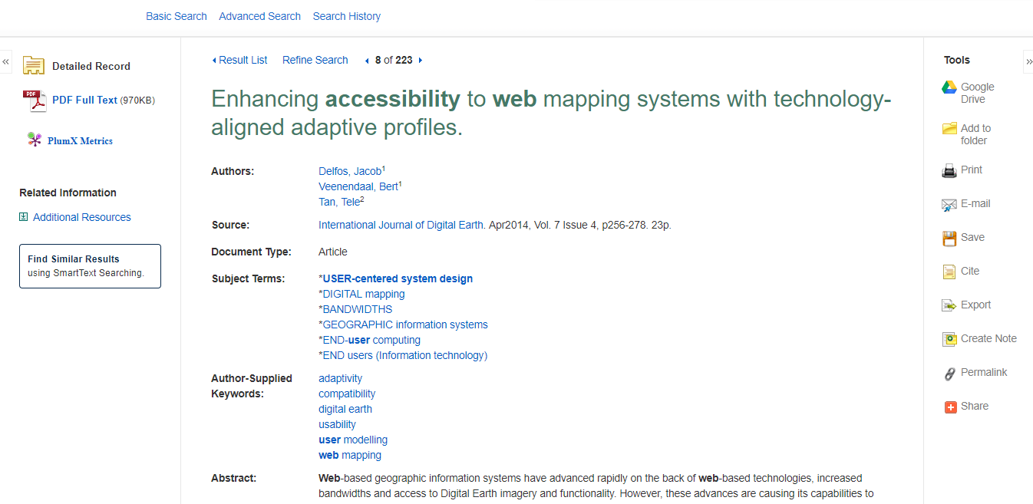
Use subject terms and author-supplied keywords to improve your search

Slide 56
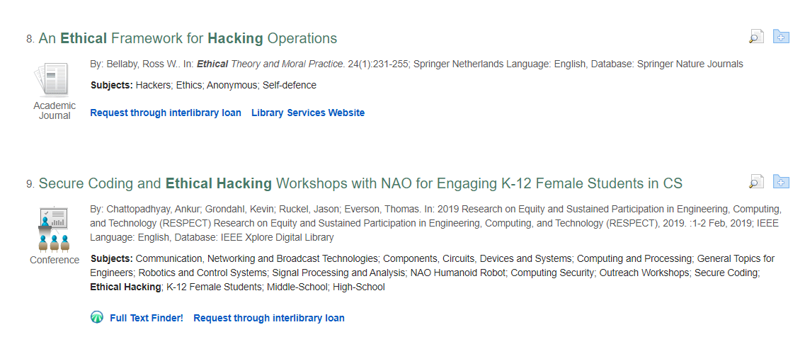
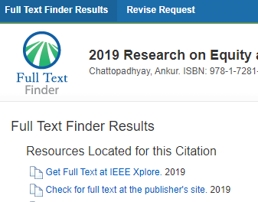
Use Full-Text Finder to link to items in other databases
Results will open in a new tab.

Slide 57
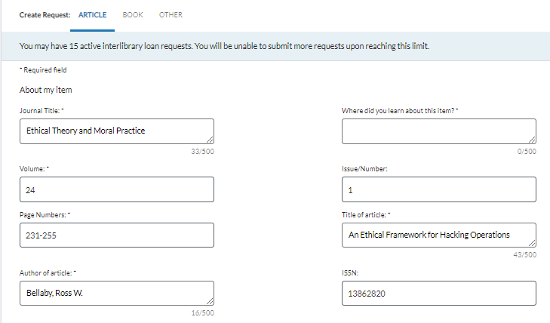
Use Request through Interlibrary Loan to request items not available
Confirm your request details and submit!

Slide 58



Library Services for Grad Students
(717) 901-5188
Interlibrary loan
Research assistance
APA assistance
Library@HarrisburgU.edu
Chat Online
https://library.harrisburgu.edu

Slide 59
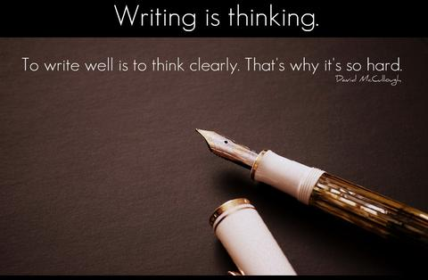
Writing Services
Writing Lab
Writing help via email is available!
Contact:
Tutoring@HarrisburgU.edu
Notes:
The Writing Center tutors are also available to help you integrate your sources with proper citation techniques.

Slide 60

Questions?

Slide 61
References
Australian Council for Educational Research. (2008). How libraries and librarians can support student engagement. Retrieved from https://www.acer.org/files/AUSSE_EG_Librarians.pdf
Literature review. (2011). In P. Stokes, Palgrave Key concepts: Key concepts in business and management research methods. Basingstoke, UK: Macmillan Publishers Ltd. Retrieved from http://navigator-harrisburg.passhe.edu/login?url=https://search.credoreference.com/content/entry/macbamm/literature_review/0?institutionId=3314
O’Kelly, M. (2015). Correlation between library instruction and student retention. Retrieved from http://scholarworks.gvsu.edu/library_presentations/55
Soria, K. M., Fransen, J., & Nackerud, S. (2013). Library use and undergraduate student outcomes: New evidence for students’ retention and academic success. Portal: Libraries and the Academy, 13(2), 147-164. doi:10.1353/pla.2013.0010
Vance, J. M., Kirk, R., & Gardner, J. G. (2012). Measuring the impact of library instruction on freshman success and persistence: A quantitative analysis. Communications in Information Literacy, 6(1), 49-58. Retrieved from http://www.comminfolit.org/index.php/cil

